Slide 1
By: Ashah Adams, ﻿Valerie Andujar, Junda Chen, Benjamin Kasman & Kaely Kwitek

Slide 2
Agenda:
Problem
Solution
Reports
Database
Enhancements

Slide 3
Problems:
Systems
Communication between employees
Keeping track of customers

Slide 4
Solution:
Centralized location
Contains original documents
Managers can access easily
Many backup options

Slide 5
Reports:
Workout Officer Debt Report
Loan Information Report
Notes:
Workout officer and customer report = The amount of debt each workout officer has because of their customers. Each work officer are assigned different set of customers.

Slide 6
Reports:
Customers Notes Report
Legal Report
Bankrupt Report
Notes:
Bankrupt Report = Shows which customers have not payed and when they need to go to legal, type of bankruptcy
Customer Notes Report = Can track the banks contact with the customers. Know customer account
Legal = who owes legal

Slide 7
Our Website:
http://tandmbank.weebly.com/

Slide 8
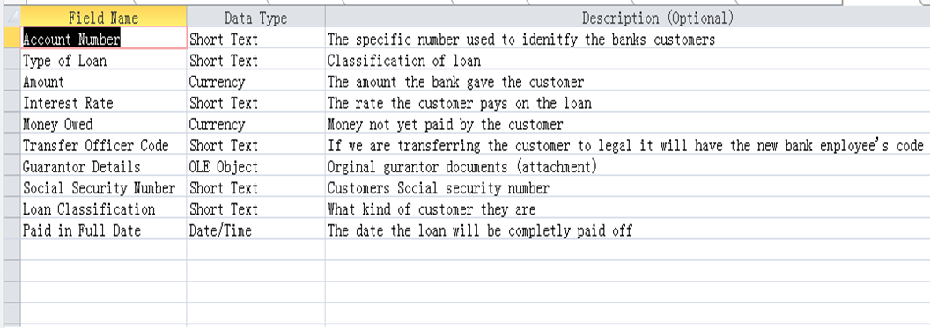
Enhancements:
(1). Description

Slide 9
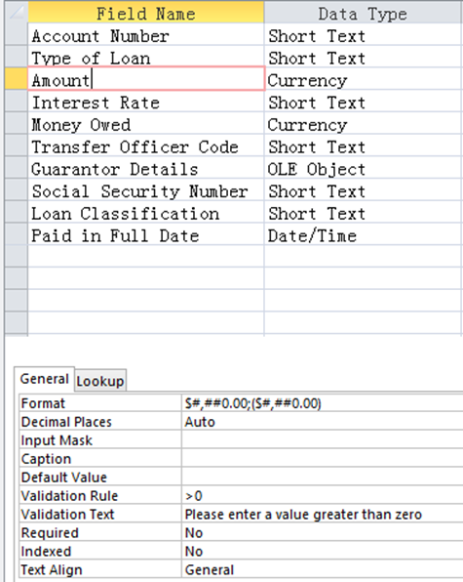
(2). Field properties
For example: Amount
Validation Rule: >0
Validation Text: Please enter
a value greater than zero

Slide 10
(3). Form buttons

Slide 11
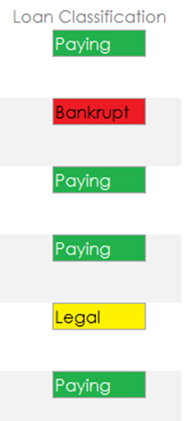
(4). Loan classification
Green: Paying customer
Red: Bankrupt
Yellow: Legal

